Slide 1

Benson C of E Primary School

Slide 2

Our School Vision

Slide 3
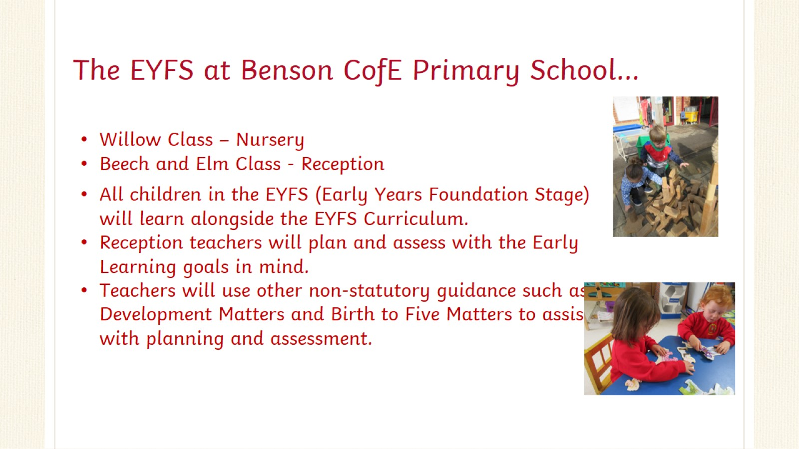
The EYFS at Benson CofE Primary School…

Slide 4
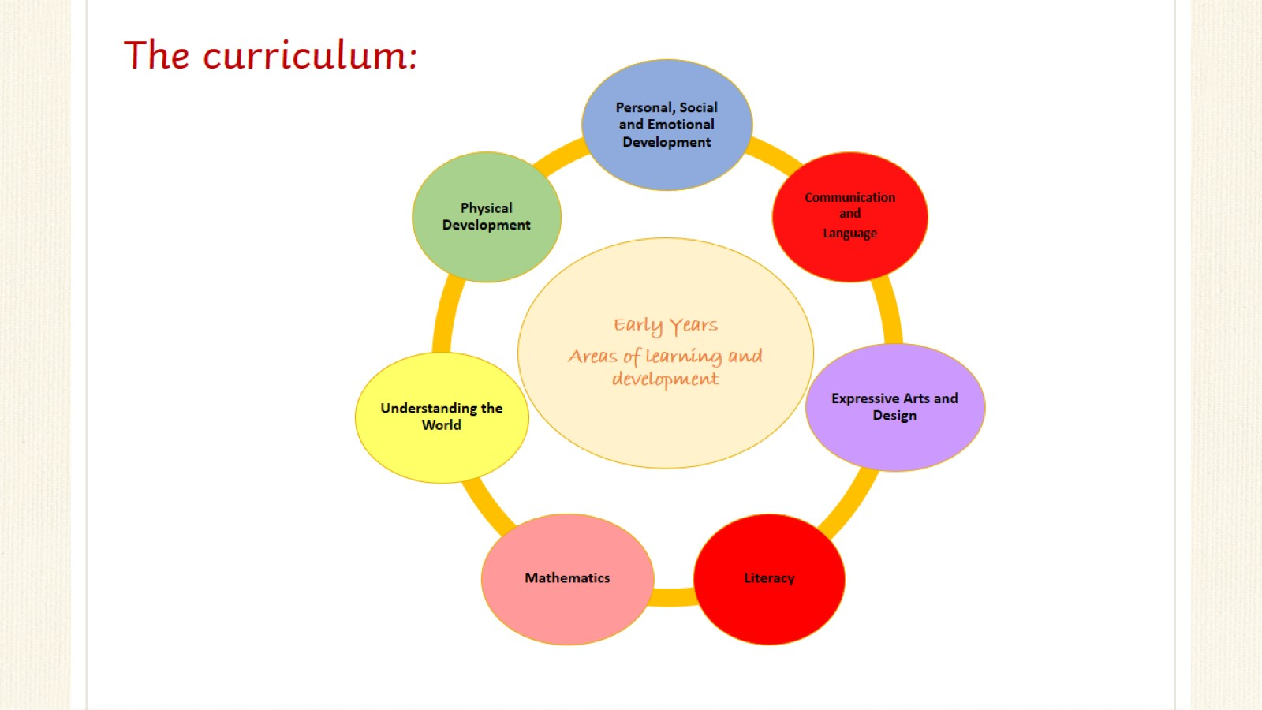

Slide 5
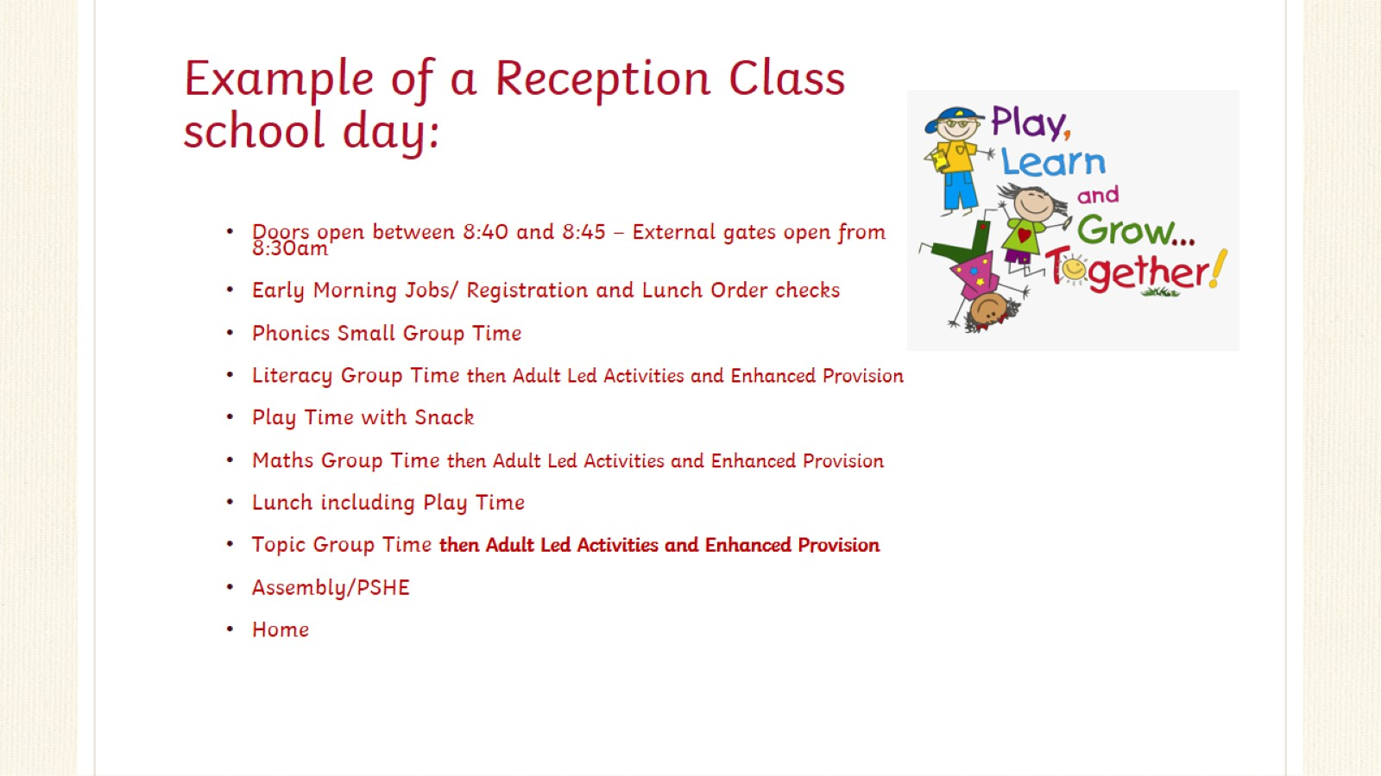
Example of a Reception Class school day:

Slide 6
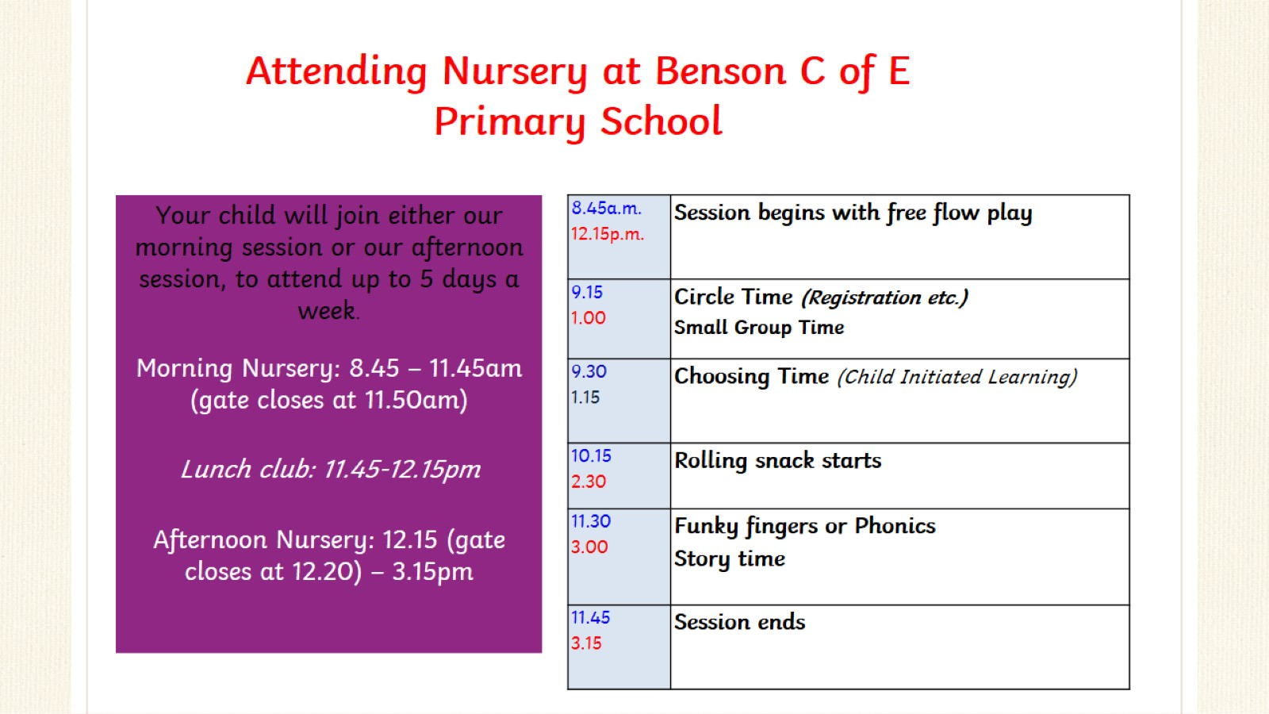

Slide 7
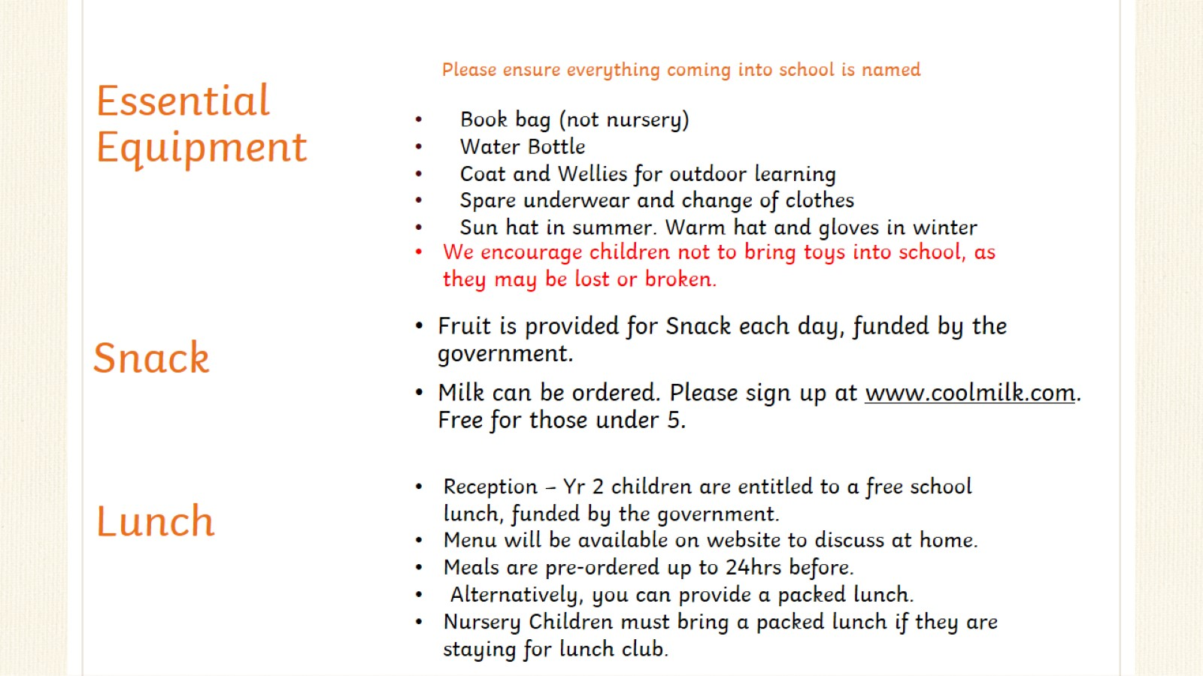
Essential Equipment

Slide 8
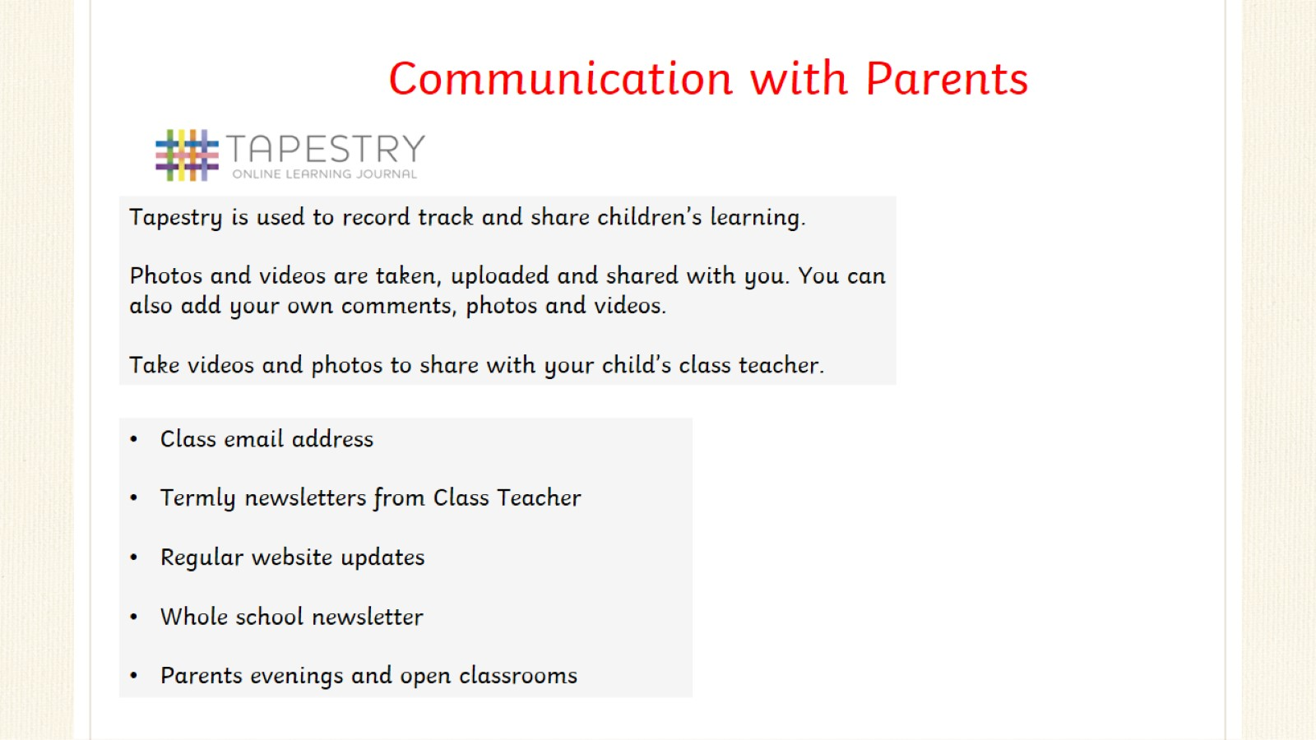

Slide 9


Slide 10
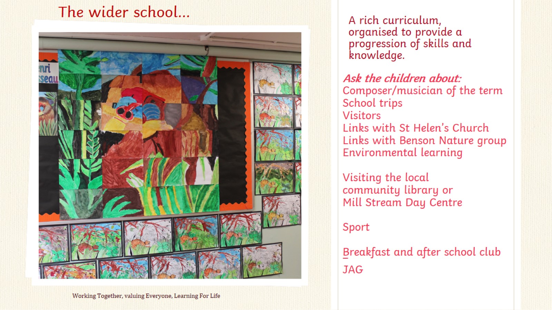
A rich curriculum, organised to provide a progression of skills and knowledge.

Slide 11
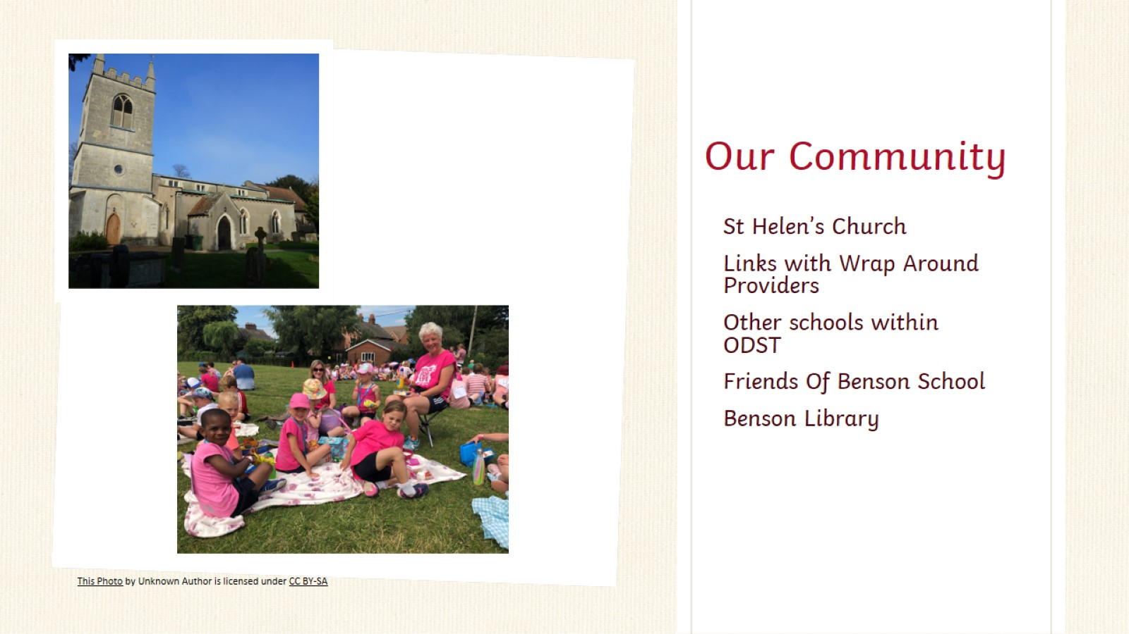
Our Community

Slide 12
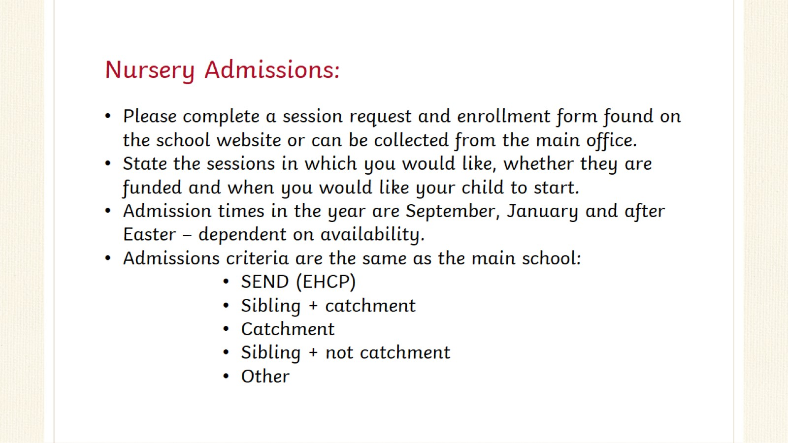
Nursery Admissions:

Slide 13
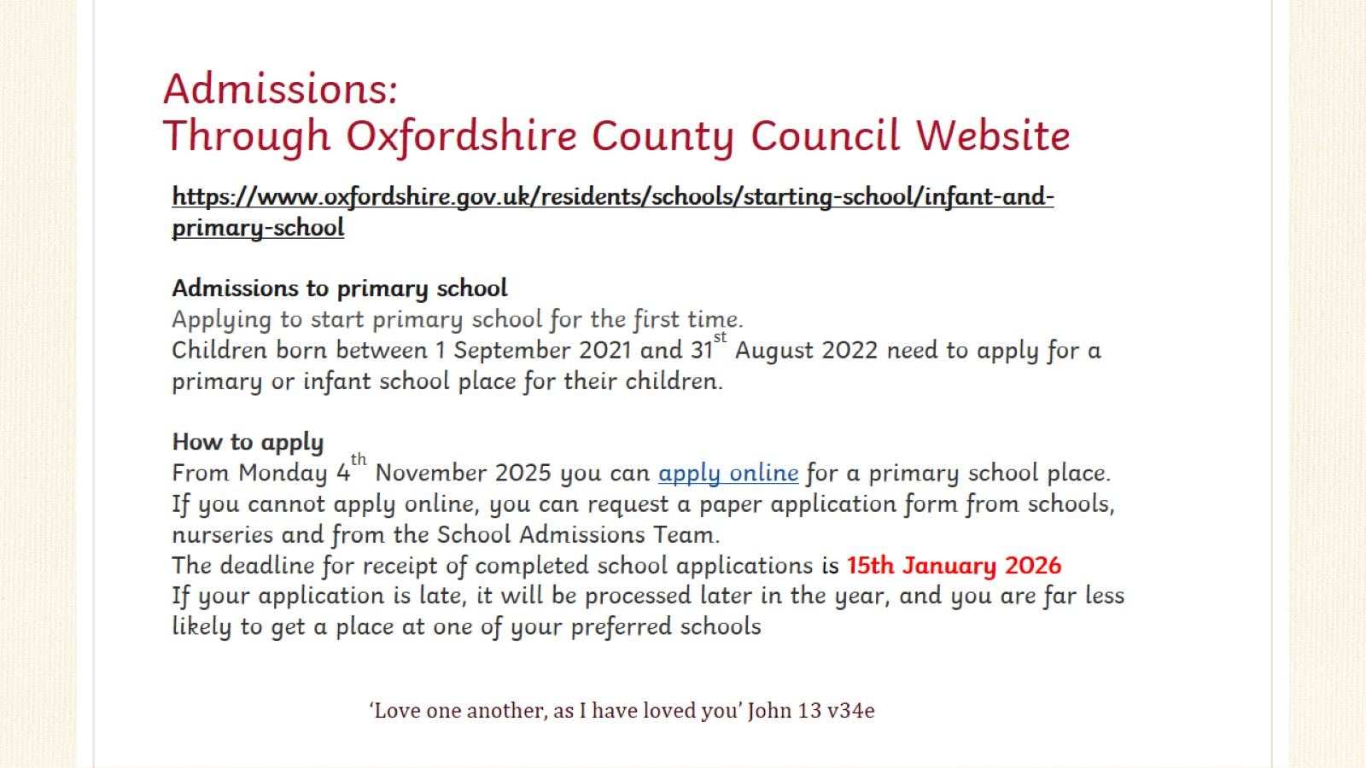
Admissions:
Through Oxfordshire County Council Website

Slide 14
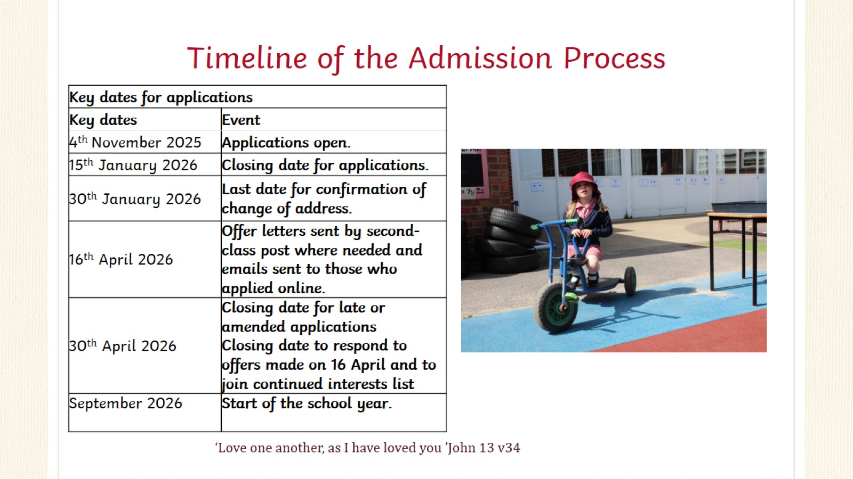
Timeline of the Admission Process

Slide 15
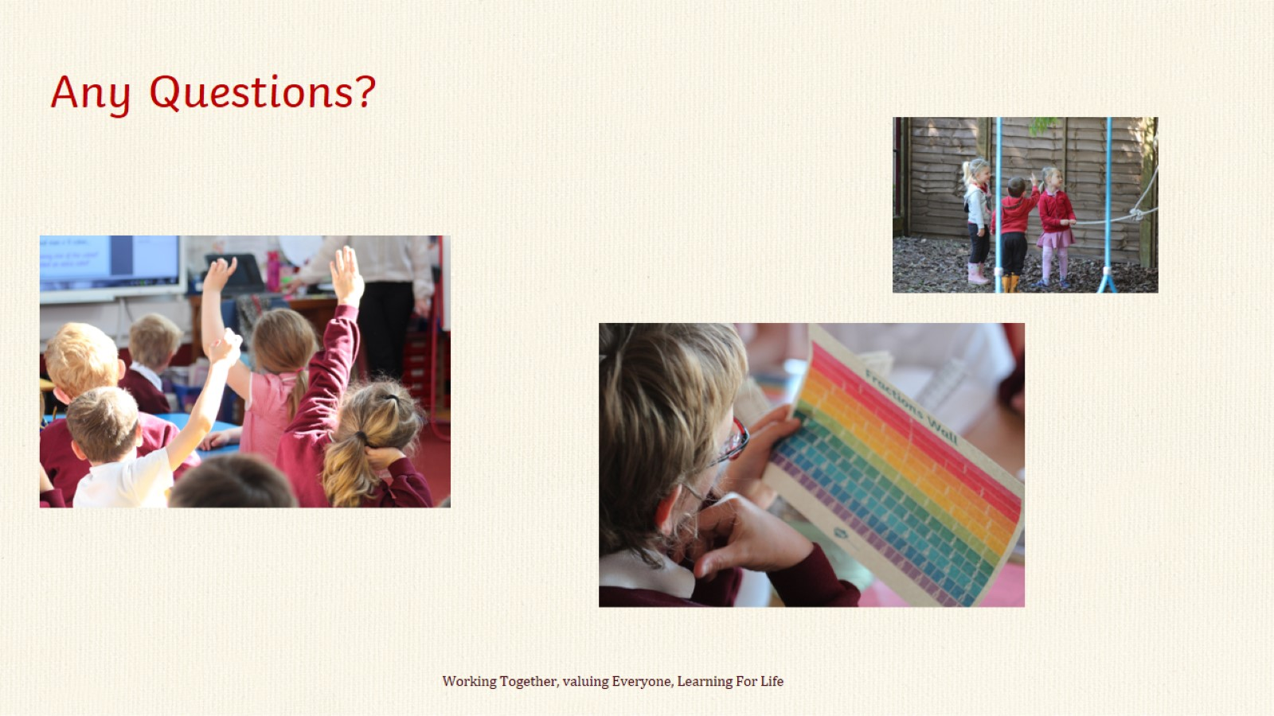

Slide 16
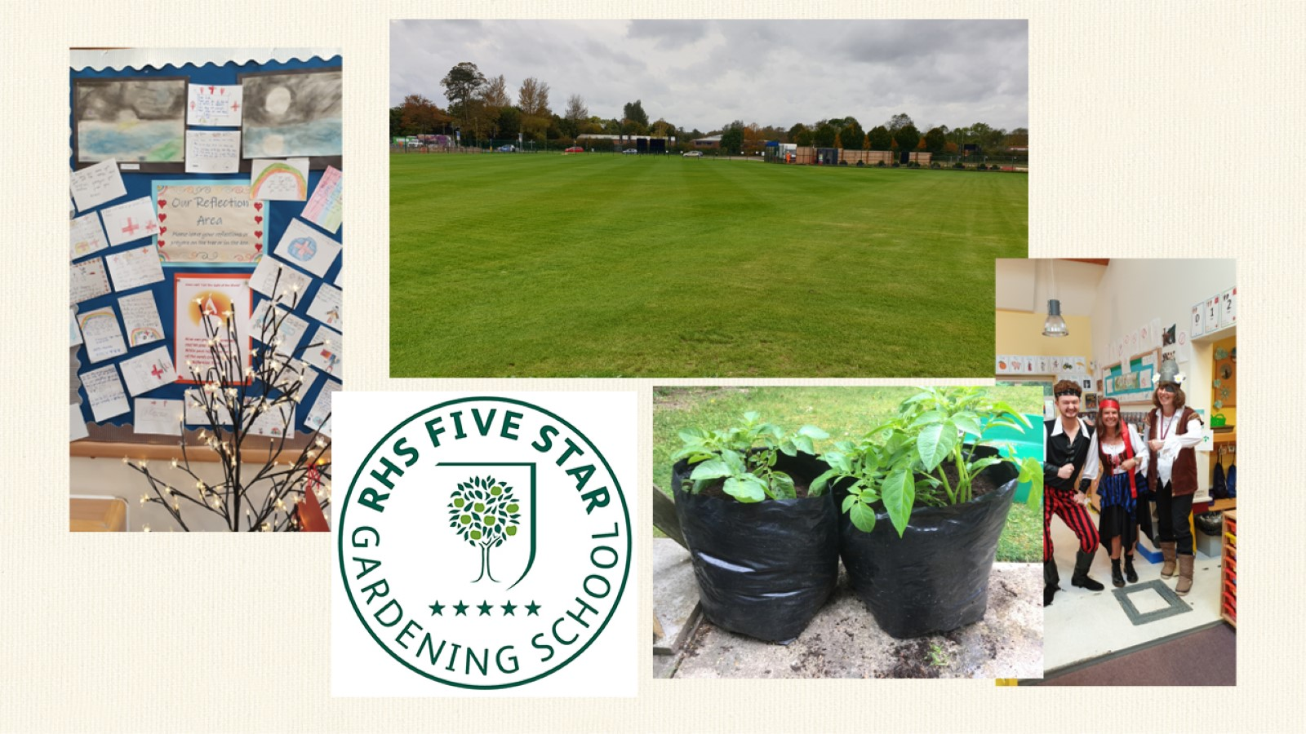

Slide 17


