Slide 1


BENSON C OF E PRIMARY SCHOOL
Parent Information
YEAR 3 & 4

Slide 2
BENSON C OF E PRIMARY SCHOOL
Orchard Staff
Teachers:
Mrs Moore- Apple Class Teacher
Mrs Gravett - Damson Class Teacher
Mrs O’Reilly - Cherry Class Teacher
TAs with Orchard classes:
Ms Carman, Mrs Gibbons, Miss Collins, Miss Munday, Miss Galloway, Mrs Hadfield, Mrs Hester, Mr Bennett

Slide 3
BENSON C OF E PRIMARY SCHOOL
School Routine
Early Work / Assembly (Tuesday, Wednesday, Friday)
Maths
Break
English / Guided Reading
Lunch
Foundation Subjects
Class Reflection (Monday and Thursday)

Slide 4
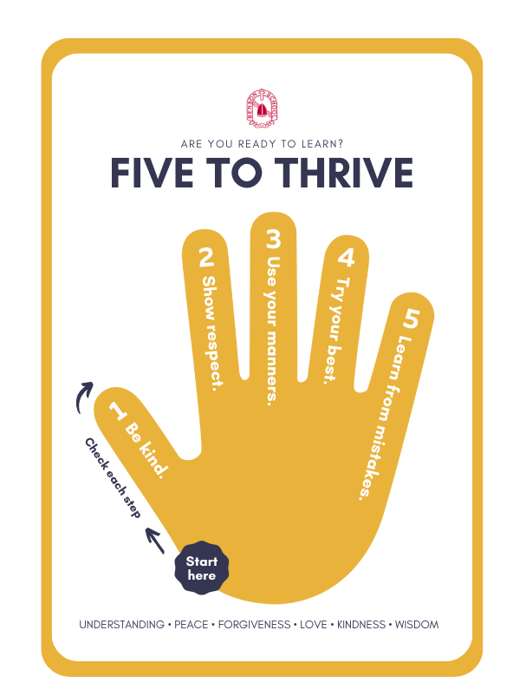
BENSON C OF E PRIMARY SCHOOL
Classroom Expectations
When children show our school values
and are good role models for our Five to
Thrive their efforts will be recognised with
a house point. At the end of each term
the winning house will be rewarded with
a non-uniform day.
Each class also has their own reward system, eg marble jar, raffle tickets.
Every Friday each class will give out two
Certificates for good presentation, displaying our school values or our Five to Thrive or an
exceptional piece of work.
We follow the school behaviour policy to ensure the children stay safe and get the best out of their learning. As per the behaviour policy children will receive three warnings before receiving a consequence such as missing some break.
When children display extreme behaviours, they will be required to see a member of the senior leadership team who will decide the necessary consequence. This is in place to ensure the children remain safe in the school.

Slide 5
BENSON C OF E PRIMARY SCHOOL
General Organisation
  Children will need a water bottle in school everyday. They may refill this in school when needed (and if they accidentally leave it overnight).
  We ask that children have clearly labelled jumpers and cardigans. Where possible if a child could also have a written name on their labels this helps us when the iron on labels fall off.
  Y3 and Y4 pupils will need their own snack as they are not entitled to free fruit unless they receive free school meals. To check if your child is entitled to free school meals, please liaise with the school office.
  Your child will need clothes appropriate for the weather. They have pegs which they can keep coats on and trays they can keep hats, gloves and scarves in for the colder months.

Slide 6
BENSON C OF E PRIMARY SCHOOL
English
All English lessons begin with a short SPaG (Spelling, Punctuation and Grammar) retrieval activity which involves the children recalling and practising previous content. This allows them to embed their learning further.
We explore different text types in (approximately) three-week sequences. These sequences build to the children writing their own final pieces. There is always a purpose for writing and, where possible, the writing links to that term’s topic.
The writing sequences begin by exploring the text type and its features. The children will then take part in experience lessons which may involve art, drama or an activity related to the text before planning their own writing.
During Big Write lessons, the children complete an extended piece of writing which becomes their first draft. The following lesson is then spent editing and improving this draft before they are given feedback on it.
After editing, and responding to feedback, the children will complete a final draft or a “published” piece.

Slide 7
BENSON C OF E PRIMARY SCHOOL
Reading
We have daily whole class reading lessons in which we all explore the same book or text. Each lesson involves reading; this may be following along while we read, while a peer reads or taking it in turns to read to a partner.
While some lessons focus on developing the children’s fluency and ability to decode, lessons will also focus on the six reading domains. We refer to these as Vipers. These domains are Vocabulary, Infer, Predict, Explain, Retrieve and Summarise.
We also have time set aside just to read: this may involve reading the book we’re studying in whole class reading, reading a different book or the children reading their own chosen book.
Children may change their reading book when needed during early morning work. To move up a reading level children must be able to meet the criteria for the end of level assessment. These assessments differ based on the level.

Slide 8
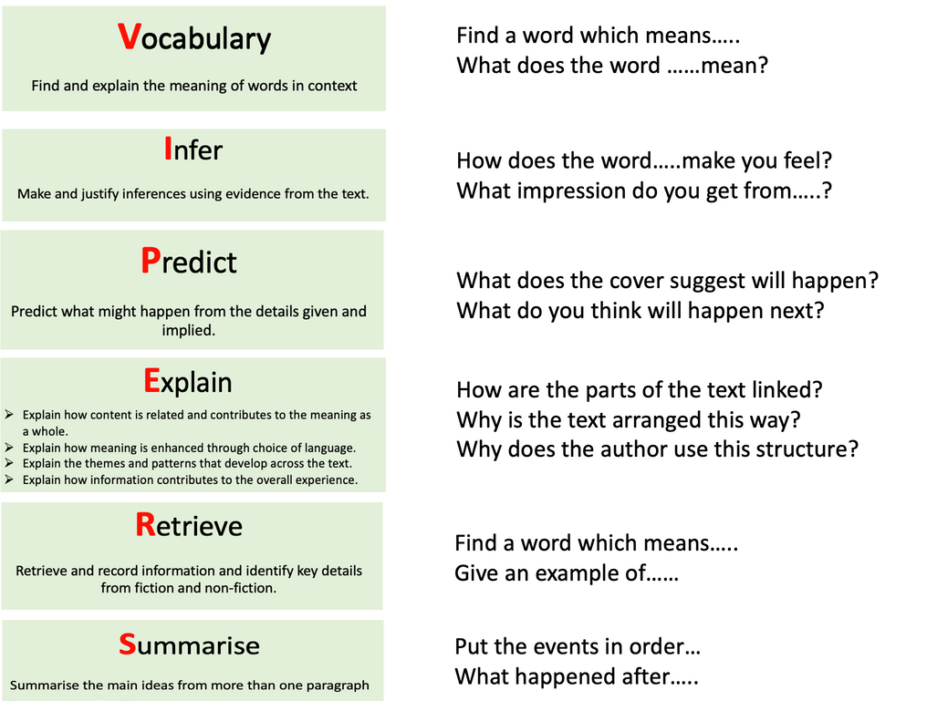

BENSON C OF E PRIMARY SCHOOL
Reading
These are some examples of the vipers we will be using in school.

Slide 9
BENSON C OF E PRIMARY SCHOOL
Maths
In Year 3 and 4, children will continue to develop their counting and calculation skills, learning different strategies for addition and subtraction, multiplication and division. Children will also work on extending their knowledge of fractions and learning how to recognize, find, name and how to find equivalent fractions. They will measure length, weight, volume, temperature, time and money, develop their knowledge of 2D and 3D shapes and begin to learn about statistics.
Much of children’s learning will continue to be practical. They will be taught to use visual representations and encouraged to use different methods when solving mathematical problems. Year 3 and 4 children will mostly be focusing on the same problem types (e.g. all doing addition at the same time) but will have differentiated input and task to appropriately/ support and challenge their current attainment. Children will be learning and using mathematical methods appropriate for their age and attainment.

Slide 10
BENSON C OF E PRIMARY SCHOOL
Statutory Times Table Test - Year 4
What is it?
It is an on-screen check consisting of 25 times table questions. Your child will be able to answer 3 practice questions before taking the actual check. They will then have 6 seconds to answer each question. On average, the check should take no longer than 5 minutes to complete.
When will it take place and what is it?
It will take place within the 2-week period in June 2026. Closer to the time we will hand out an information pack from the government giving you details about the check.
What happens after the check?
Schools will have access to all their pupils’ results, allowing those pupils who need additional support to be identified. We will then share your child’s score with you, as we would with all national curriculum assessments. There is no pass mark for the check.

Slide 11
BENSON C OF E PRIMARY SCHOOL
Statutory Times Table Test - Year 4
Statutory Times Table Test - Year 4
What will we do to support your child?
We will be practising our times tables via songs and chants and written activities.
Closer to the time we will plan in a Maths session on the iPads or Chrome Books to familiarise the children with using the keypad to answer questions.
The government will provide us with a ‘Try it out.’ section closer to the date, where we will be able to practice on their official system familiarising ourselves with timings and the layout.

Slide 12
BENSON C OF E PRIMARY SCHOOL
Statutory Times Table Test - Year 4
Statutory Times Table Test - Year 4
What can you do to support your child?
Practise with your children using this format: 2 x 2 = 4, 3 x 4 =12.
Get them to access TimeTable Rockstars at home (all children in Y3 and Y4 will have their own login).
Practice using fun games! Here are some games and songs they might line to use to practice:
    Times tables games - Timestables.co.uk
    Times Tables Games for 7 to 11 year olds (topmarks.co.uk)
    AdaptedMind
    Bing Videos

Slide 13
BENSON C OF E PRIMARY SCHOOL
Science
Each term, we have a different science topic which may have a biology, chemistry or physics focus.
This year the children will study these different subject areas:
    Living things and their habitats & food chains.
    Animals inc Humans: Digestion, teeth.
    Materials
    Electricity
    Sound
Each of these topics is a combination of scientific knowledge and understanding with as much practical exploration as possible. The science lessons will help the children to develop different scientific skills including:
    performing simple tests
    identifying and classifying
    using their observations and ideas to suggest answers to questions
    gathering and recording data to help in answering questions

Slide 14
BENSON C OF E PRIMARY SCHOOL
Humanities
We will study a geography or history topic each term and usually our overarching topic for the term is linked to this.
A topic web will be be published each term with details of our learning across the curriculum.

Slide 15
BENSON C OF E PRIMARY SCHOOL
PE
This year each class will attend swimming lessons for two terms each at Berinsfield pool. This session will be on a Monday morning, with further details to follow. Apple class will be swimming in terms 1 and 2, Damson in terms 3 and 4 and Cherry in terms 5 and 6.
During the non-swimming terms PE days are as follows:
  Apple Class - Thursday
  Cherry Class - Monday
  Damson Class – Tuesday
In PE we focus on developing lots of different skills and explore many different sports. Each term half term we change our sport focus to give children the opportunity to try as many sports as possible.

Slide 16
BENSON C OF E PRIMARY SCHOOL
Homework
Children should read and practise their timestables as much as possible. They should also practise the Y3/4 statutory words (on the class page)..
In terms 2,4 and 6 there will be an OPTIONAL project linked to the topic in the following term.

Slide 17
BENSON C OF E PRIMARY SCHOOL
School Website
You can use the school website which will give you access to the school calendar, newsletter and our class page.
On the class page you will be able to access spellings, class notices and key dates. We also have a class blog on the webpage; this blog is updated weekly and includes an overview of the week and some photos.

Slide 18
BENSON C OF E PRIMARY SCHOOL
Contact Us
If you have any concerns or anything you'd like to discuss urgently, please call the school office and they will be able to help you. If your child is going to be absent from school, please let the office know as soon as possible.
If you wish to talk to us about less urgent problems, we are available via our class email addresses:
  apple@benson.oxon.sch.uk
  cherry@benson.oxon.sch.uk
  damson@benson.oxon.sch.uk
We are also available most mornings and at pick up times. If you have a question or concern which cannot be addressed through email/ a quick chat, we can then arrange a time for a meeting or a call.

Slide 19

BENSON C OF E PRIMARY SCHOOL
Any questions?

