Slide 1

Beech and Elm Reception Information Meeting
Please sign in

Slide 2
Beech Class – Mrs White & Mrs Omer
Elm Class – Mr Morris

Slide 3

Agenda
Key Class Information
Reading Groups
Reception Baseline
Key documents to take home today

Slide 4

Essential Equipment
Please ensure everything coming into school is named
Book bag
Water Bottle (no glass bottles)
Coat and Wellies for outdoor learning
Spare underwear and change of clothes
Sun hat in summer. Warm hat and gloves in winter
Toys from Home
We would encourage children not to bring toys into school, as they may be lost or broken.
Snack
Fruit is provided for Snack each day, funded by the government. Milk can be ordered. Please sign up at www.coolmilk.com. Free for those under 5.
All Early Years children are entitled to a free school lunch, funded by the government.
Free School Meals update – form in pack to complete
Menu will be available on website to discuss at home.
Book first week in September through Class Teacher. School Money log in will be provided after the first week.
Alternatively, you can provide a packed lunch.
Run by school from September. Booking available via website from Thursday 2nd July 2026
Lunch
Wrap Around Care

Slide 5

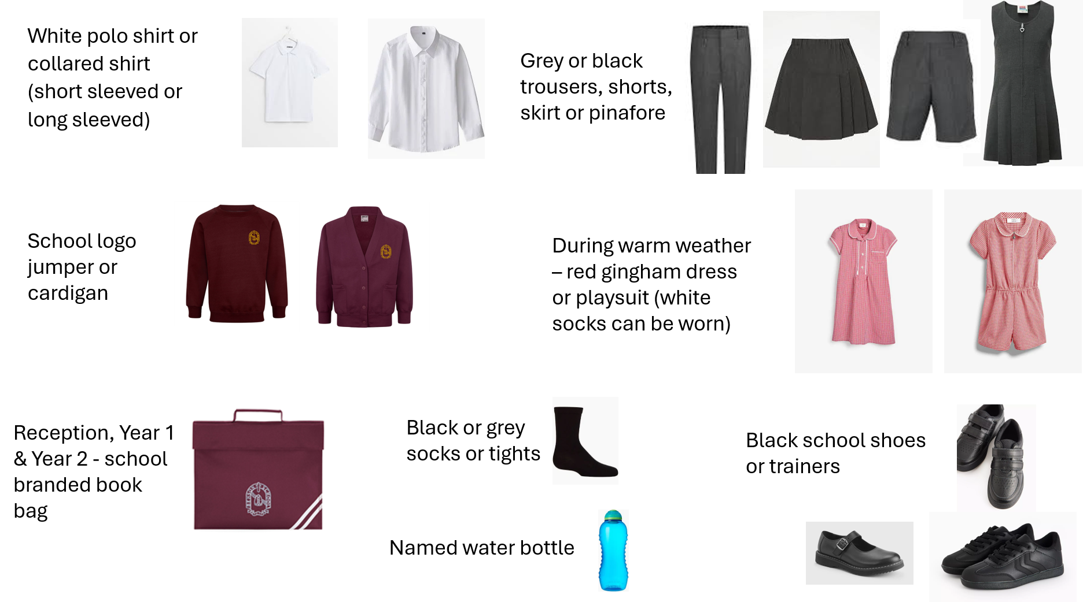
School Uniform
All uniform information can be found on school website. Please label all items.

Slide 6
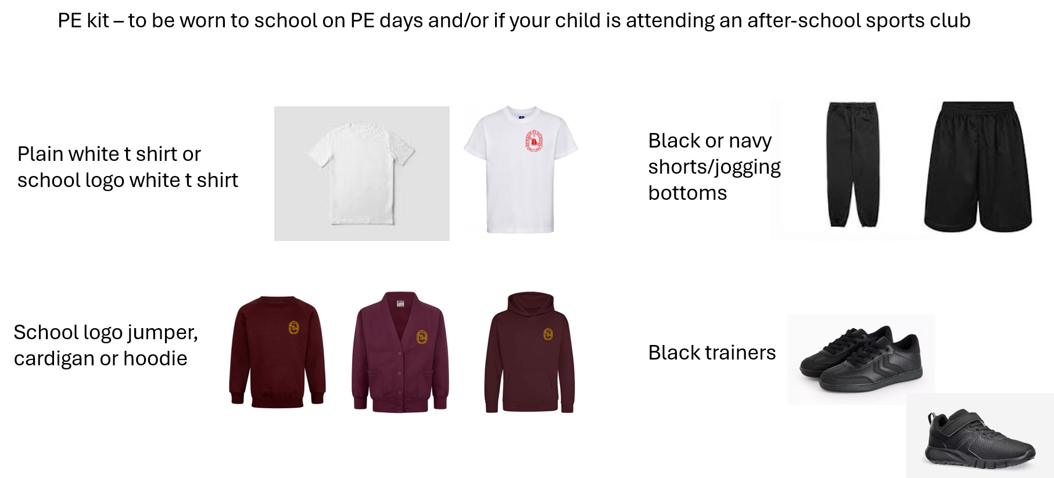
PE day TBC

Slide 7
A typical day in Reception
Morning
8:40: Settling in/focus morning work
8:45 – Registration (9:00 assembly on certain days)
9:10 – Phonics
9:45 – Snack Time
10:00 - Everybody outside for break & outdoor play in any weather like forest school to experience the seasons through the year and the clothes needed in different weathers
10:30 - Maths burst then indoor choosing
11:15 - Tidy up time then lunchtime routine
11:30 -12:30 – Lunchtime
Afternoon
12:30 – Relaxation time
12:45 – Storytime/Literacy
12:50- Afternoon lesson input, either colourful semantics, RE, PE, Super Stretching or PHSE.
1:00 - Focus group work in the children’s work books on a fortnightly basis - 1 week lit, 1 week maths and also choosing and free flow - interventions can take place once focus group work for that day has finished
2:30 - Tidy up time
2:45 – End of the day circle time or topic work input
3:00 – End of the day routine
3:10 – School gates open for pick up

Slide 8
Guided Reading Groups
Monday | Robins
Tuesday | Nightingales
Wednesday | Goldfinches
Thursday | Sparrows
Friday | Starlings

Slide 9
Reading Groups
Reception – 2 books per week.
  One book is the levelled rocket phonics book which will be issued after they have completed their first 6 weeks of phonics teaching and the other book is a free choice Library book.

Slide 10
Reading Groups
Other activities you can do if your child has finished the books or does not want to read:
copying their favourite words/phrase or sentences from the book
create a story map of the book using pictures
draw pictures and write speech bubbles for characters in the book
drawing/writing an alternative ending or beginning to the book (You can scribe sentences for them, or they can copy words that you have written)
https://home.oxfordowl.co.uk/ provides ebooks for all age groups
practising sounds and common exception words (Word of the Day)

Slide 11


Reception Baseline – to be completed within the 1st 6 weeks of school
Statutory activity-based assessment of children’s starting points in language, communication, Literacy and Maths.
Reception will be supported by their class teacher to complete short tasks using fun and practical resources.
Details have been emailed to you and more information be available on the school website.
Tapestry is a secure online learning journal system used by the school to record, track and share children’s learning.
Photos and videos are taken using Tapestry, uploaded and shared with you. There is an option for you to add your own comments.
You can also take videos and photos of home learning experiences to share with your child’s class teacher and add to your child’s Online Tapestry Learning Journal.

Slide 12

Website​
Please do look at the website for key information – this Powerpoint will be added on the class pages
Read the weekly Head Teacher newsletter.
Topics Web is shared on website​​
Transition Morning: THURSDAY 2nd JULY
Drop your child at their new classroom door at 9.30am – Please wait at the big gates on Horseshoes Lane
The children will be welcomed into the classroom and will go and play. A quick goodbye does the trick!
Children will be offered snack during the morning.
Pick up time 11.30am from Classroom door – Parents enter through same gate.
Class emails
Mr Morris: elm@benson.oxon.sch.uk
Mrs White & Mrs Omer: beech@benson.oxon.sch.uk

Slide 13

Key documents to complete
Enrolment form (not including children currently at our Nursery) We must have contact details for more than one parent/carer
Permissions form
Pupil Premium/ Free School Meals (targeted or expanded)
Sign up to Cool Milk – scan QR code or visit www.coolmilk.com/parents
Individual Health Care Plan – for those children with a medical condition or allergies

