Slide 1


Maple, Oak and Chestnut Class
Information Session

Slide 2
Agenda
Key Class Information
Reading Groups
Year One Phonics Screening
English
Maths
New this year

Slide 3

Please ensure everything coming into school is named!
Essential Equipment
Book bag
Water Bottle
Coat
Spare underwear and change of clothes
Sun hat in summer. Warm hat and gloves in winter
PE kit to be worn on PE days and /or if your child is attending an afterschool sports club
Apron /old shirt for Art Club
Toys from Home
Please do not bring toys into school, as they may be lost or broken.
Snack
Fruit is provided for a snack each day, funded by the government.
Milk can be ordered. Please sign up at www.coolmilk.com
Milk is free for all children on means-tested Free School Meals.
Lunch
Menus are available on the school website to discuss at home.
School dinners need to be preordered.
Alternatively, you can provide a packed lunch. If your child has a packed lunch, please make sure any preordered school lunches for that day have been cancelled.

Slide 4
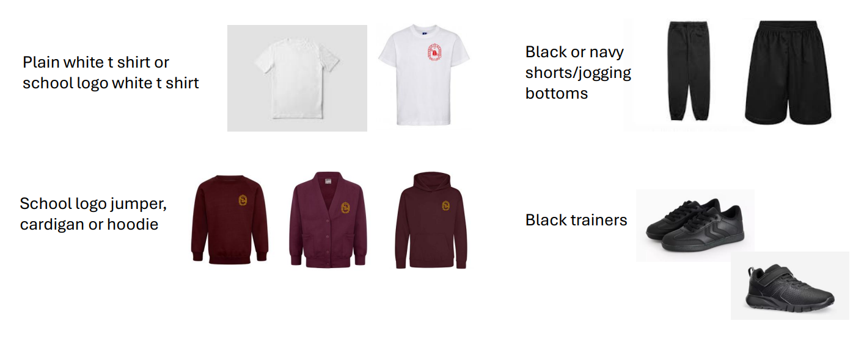
Physical Education
PE Must dos
Please make sure long hair is tied up
Please tape earrings for safety reasons or take them out if possible
PE Days
Maple - Monday
Oak - Wednesday
Chestnut - Friday

Slide 5
Weekly timetable
Please click on the individual class page icon for your child’s weekly timetable.
Please also note that ‘Show and Tell’ will be on Mondays only.
Appropriate things to share include:
items related to the topic of the term.
certificates/medals
photos of a recent holiday/learning experience

Slide 6
Reading
Reading Groups
Monday | Robins
Tuesday | Nightingales
Wednesday | Goldfinches
Thursday | Sparrows
Friday | Starlings
2 books per week
1 book is a Rocket Phonics book which they should be able to read independently.
1 book is a phonetic book in line with their abilities, however some of these may contain some tricky words they haven’t covered before so they may need some help.
Books need to be in school every day.

Slide 7
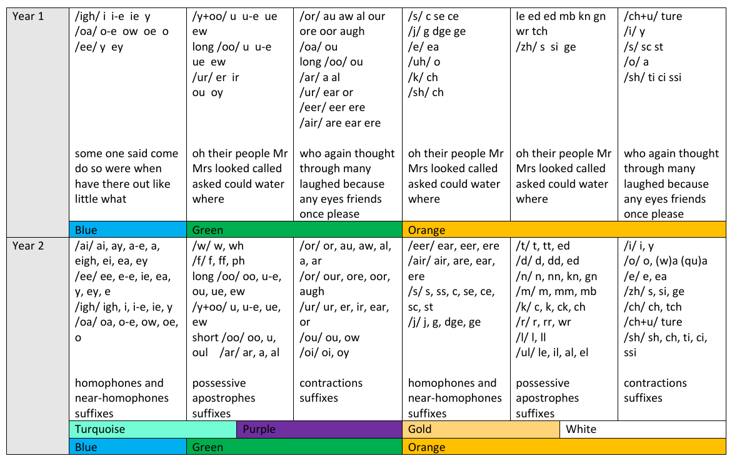
Reading level expectations linked to Rocket Phonics Scheme

Slide 8
Year 1 phonics screening
In Term 6, all Year 1 children take part in a Phonics Screening Check to assess and show how well they use and apply the phonics skills they have learnt.
The class teacher can then identify children who need more support with phonics going into Year 2.
A meeting will be held nearer the time with more information.

Slide 9
Supporting your child’s learning
Reading and Writing
Encourage daily reading
Practise writing name using correct letter formation
Practise writing common exception words
Other activities you can do if your child has finished the books or does not want to read:
copying their favourite words/phrase or sentences from the book
create a story map of the book using pictures
draw pictures and write speech bubbles for characters in the book
drawing/writing an alternative ending or beginning to the book (You can scribe sentences for them, or they can copy words that you have written.)
practising sounds and common exception words (Word of the Day)
https://home.oxfordowl.co.uk/ provides free ebooks for all age groups
Maths
Practise key skills - number formation, number bonds within and to 10 and one to one counting
Telling the time (analogue clock)
Money – making amounts using different coins and working out change
Regular Times Table Rock Stars (TTRS). A ‘little and often’ approach works well to improve recall speed of 2, 5 & 10 times tables in Y2. Children can then confidently build on this knowledge as they begin to work towards the Year 4 multiplication tables check.
If Year 1 children are not ready to engage with TTRS, try again later in the term. They do not need to know the x symbols but benefit from practising counting in 2s 5s and 10s.
Logins are available for each child

Slide 10


Learning in the classroom

Slide 11
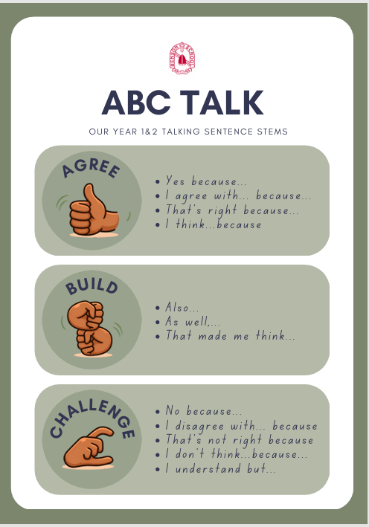
New this year…

Slide 12
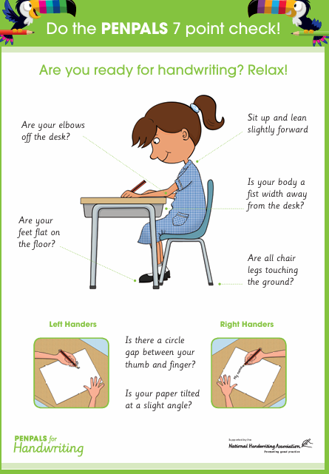

PenPals for Handwriting
The scheme focuses on correct posture for writing, using the correct tripod grip and aims to develop legible and partly joined handwriting style by the end of Year 2.

Slide 13
Mrs Thomas: chestnut@benson.oxon.sch.uk
Miss Turner Hurd: oak@benson.oxon.sch.uk
Mrs Harpham and Mr Turner-Fussell:
maple@benson.oxon.sch.uk
Website​: More information can be found on the class pages, including the termly Topic Web.

